Slide 1

CC 141 Discrete Structures Department of Computer Science School of Systems and Technology University of Management and Technology Lahore, Pakistan

Slide 2
Chapter 10 Graph Theory

Slide 3
INTRODUCTION
Graph theory plays an important role in several areas of computer science such as:
Switching Theory and Logical Design
Artificial Intelligence
Formal Languages
Computer Graphics
Operating Systems
Compiler Writing
Information Organization and Retrieval.

Slide 4
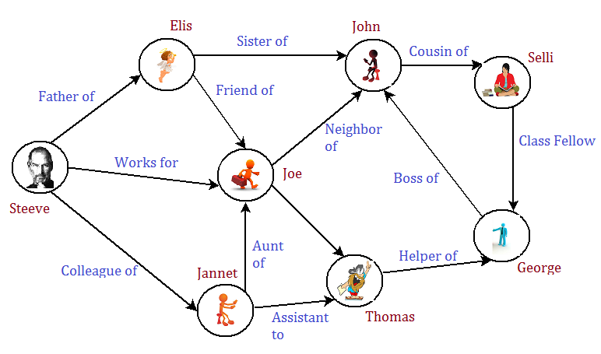
Graph … Examples
Social Network Graph
Individuals and their friends refer to social networks and their arrangement reflects a graph. Individuals in social networks and relationships among different individuals make up social network graph.
Social Network:

Slide 5
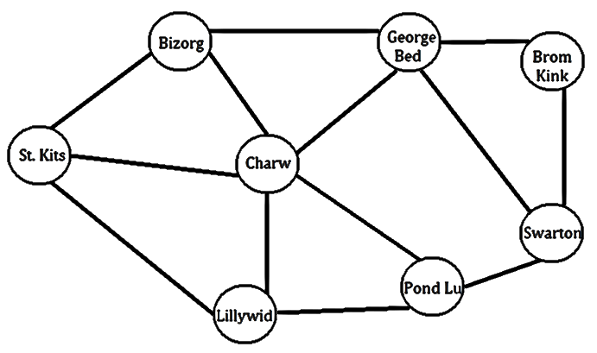
Graph … Examples
Road Network Graph
Cities may be referred as vertices and roads joining them are the edges of the graph.
Road Network Example

Slide 6
Graph … More Examples
Car Navigation System
Artificial Intelligence
Graph of Web
Professional Network Graph
Course Pre-reqs Graph
Job Execution Graph
Operating Systems
Airline Routes
Many more….

Slide 7
GRAPH
A graph is a non-empty set of points called vertices and
A set of line segments joining pairs of vertices called edges.
Formally, a graph G = (V, E) consists of two finite sets:
A set V = V(G) of vertices (or points or nodes)
A set E = E(G) of edges;
where each edge corresponds to a pair of vertices.

Slide 8
EXAMPLE
We have five vertices labeled by v₁, v₂, v₃, v₄, v₅ .
We have edges e₁, e₂, e₃, e₄, e₅, e₆ .
e₁ edge is for vertices v₁ and v₂ .
e₂ and e₃ end points are v₁ and v₄.
e₄ has end points v₂ and v₄ .
e₅ has end points v₂ and v₃ .
e₆ is a loop .

Slide 9
SOME TERMINOLOGY
An edge connects either one or two vertices called its endpoints (edge e₁ connects vertices v₁ and v₂ described as {v₁, v₂} i.e v₁ and v₂ are the endpoints of an edge e₁).

Slide 10
SOME TERMINOLOGY
An edge with just one endpoint is called a loop. Thus a loop is an edge that connects a vertex to itself (e.g., edge e₆ ).
Two vertices that are connected by an edge are called adjacent; and a vertex that is an endpoint of a loop is said to be adjacent to itself.
An edge is said to be incident on each of it endpoints(i.e. e₁ is incident on v₁ and v₂ ).
A vertex on which no edges are incident is called isolated (e.g., v₅)
Two distinct edges with the same set of end points are said to be parallel (i.e. e₂ & e₃).

Slide 11
EXAMPLE
Define the following graph formally by specifying its vertex set, its edge set, and a table giving the edge endpoint function.
Solution:
Vertex Set = {v₁, v₂, v₃, v₄}
Edge Set = {e₁, e₂, e₃}
Edge - endpoint function is:
Edge | Endpoint
e₁ | {v₁, v₂}
e₂ | {v₁, v₃}
e₃ | {v₃}

Slide 12
EXAMPLE
For the graph shown below:
Find all edges that are incident on v₁;
Find all vertices that are adjacent to v₃;
Find all loops;
Find all parallel edges;
Find all isolated vertices;

Slide 13
SOLUTION
Find all edges that are incident on v₁?
v₁ is incident with edges e₁, e₂ and e₇
Find all vertices that are adjacent to v₃?
vertices adjacent to v₃ are v₁ and v₂
Find all loops?
Loops are e₁ and e₃
Find all parallel edges?
Only edges e₄ and e₅ are parallel
Find all isolated vertices?
The only isolated vertex is v₄ in this Graph.

Slide 14
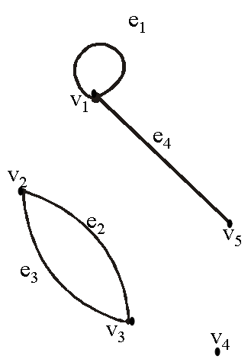
EXERCISE
Draw picture of Graph H having vertex set {v₁, v₂, v₃, v₄, v₅} and edge set {e₁, e₂, e₃, e₄} with edge endpoint function:
Solution:
Given V(H) = {v₁, v₂, v₃, v₄, v₅} and
E(H) = {e₁, e₂, e₃, e₄}
with edge endpoint function
Edge | Endpoint
e₁ | {v₁}
e₂ | {v₂, v₃}
e₃ | {v₂, v₃}
e₄ | {v₁, v₅}

Slide 15
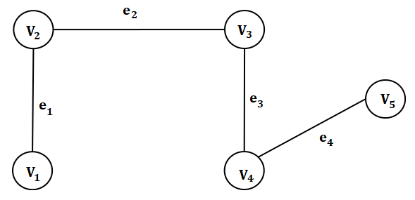
SIMPLE GRAPH
A simple graph is a graph that does not have any loop or parallel edges.
Example:
These are simple graphs, each graph has 5 vertices and 4 edges.
V(G) = {v₁, v₂, v₃, v₄, v₅} & E(G) = {e₁, e₂, e₃, e₄}

Slide 16
EXERCISE
Draw all simple graphs with the four vertices {u, v, w, x} and two edges, one of which is {u, v}.
Solution:
We are given four vertices {u, v, w, x} and one edge is {u, v}.
Since we are interested in simple graph so we cannot take {u, v} again.
There are C(4,2) = 6 ways of choosing two vertices from 4 vertices.
These edges may be listed as:
{u, v}, {u, w}, {u, x}, {v, w}, {v, x}, {w, x}
One edge of the graph is specified to be {u, v}, so any of the remaining five from this list may be chosen to be the second edge.
This required graphs are:

Slide 18
DEGREE OF A VERTEX
Let G be a graph and v a vertex of G. The degree of v, denoted deg(v), equals the number of edges that are incident on v, with an edge that is a loop counted twice.
The total degree of G is the sum of the degrees of all the vertices of G.
The degree of a loop is counted twice.

Slide 19
EXAMPLE
Find the degree of every vetex of the graph and the total degree of the graph shown
deg (v₁) = 0, since v₁ is isolated vertex.
deg (v₂) = 2, since v₂ is incident on e₁ and e₂.
deg (v₃) = 4, since v₃ is incident on e₁,e₂ and the loop e₃.
Total degree of G = deg(v₁) + deg(v₂) + deg(v₃)
= 0 + 2 + 4 = 6
NOTE
The total degree of G, which is 6, equals twice the number of edges of G,
which is 3.
This is always the case the total degree of graph is always twice the number of edges in that graph. This is actually the theorem called Handshaking Theorem.

Slide 20
THE HANDSHAKING THEOREM
If G is any graph, then the sum of the degrees of all the vertices of G equals twice the number of edges of G.
Specifically, if the vertices of G are v₁, v₂, …, v_{n}, where n is a positive integer, then
The total degree of
G = deg(v₁) + deg(v₂) + … + deg(v_{n})
= 2 . (the number of edges of G)
Corollary
The total degree of G is an even number

Slide 21
EXERCISE
Draw a graph with the specified properties or explain why no such graph exists.
(i) Graph with four vertices of degrees 1, 2, 3 and 3
(ii) Graph with four vertices of degrees 1, 2, 3 and 4
(iii) Simple graph with four vertices of degrees 1, 2, 3 and
4.

Slide 22
Solution
(i) Graph with four vertices of degrees 1, 2, 3 and 3
Total degree of graph = 1 + 2 + 3 + 3
= 9 an odd integer
Hence by Hand-Shaking Theorem, first graph is not possible.
(ii) Graph with four vertices of degrees 1, 2, 3 and 4
Total degree of graph = 1 + 2 + 3 + 4
= 10 an even integer
The vertices a, b, c, d have degrees 1, 2, 3, and 4 respectively
(i.e. graph exists).
deg(a) = 1 deg(b) = 2
deg(c) = 3 deg(d) = 4

Slide 23
(iii) Simple graph with four vertices of degrees 1, 2, 3 and 4.
Suppose there was a simple graph with four vertices of degrees 1, 2, 3, and 4. Then the vertex of degree 4 would have to be connected by edges to four distinct vertices other than itself because of the assumption that the graph is simple (and hence has no loop or parallel edges.) This contradicts the assumption that the graph has four vertices in total.
Hence there is no simple graph with four vertices of degrees 1, 2, 3, and 4, so simple graph is not possible in this case.

Slide 24
EXERCISE
Suppose a graph has vertices of degrees 1, 1, 4, 4 and 6. How many edges does the graph have?
SOLUTION:
The total degree of graph = 1 + 1 + 4 + 4 + 6
= 16
⇒ Number of edges of graph =

Slide 25
COMPLETE GRAPH
A complete graph on “n” vertices is a simple graph in which each vertex is connected to every other vertex and is denoted by K_{n} (K_{n} means that there are n vertices).

Slide 26
REGULAR GRAPH
A graph G is regular graph of degree k or k-regular if every vertex of G has degree k.
In other words, a graph is regular if every vertex has the same degree.
Following are some regular graphs.

Slide 27
EXERCISE
Draw two 3-regular graphs with six vertices.
SOLUTION:

Slide 28
BIPARTITE GRAPH
A bipartite graph G is a simple graph whose vertex set can be partitioned into two mutually disjoint non empty subsets A and B such that the vertices in A may be connected to vertices in B, but no vertices in A are connected to vertices in A and no vertices in B are connected to vertices in B.

Slide 29
MATRIX REPRESENTATIONS OF GRAPHS
To store graph in computer with pictorial representation is not possible rather you will store the graph with matrix representation.
It is difficult to analyze a big complex graph with hundreds of vertices and thousands of edges, but in matrix form you can analyze big graph better.

Slide 30
MATRIX
An m × n matrix A over a set S is a rectangular array of elements of S arranged into m rows and n columns:
↑
j^{th} column of A
Briefly, it is written as: A = [a_{ij} ] _{m×n}

Slide 31
ADJACENCY MATRIX OF A GRAPH
Let G be a graph with ordered vertices v₁, v_{2,}..., v_{n}. The adjacency matrix of G is the matrix A = [a_{ij}] over the set of non-negative integers such that
a_{ij} = the number of edges connecting v_{i} and v_{j}
for all i, j = 1, 2, …, n.
OR
The adjancy matrix say A= [a_{ij}] is also defined as

Slide 32
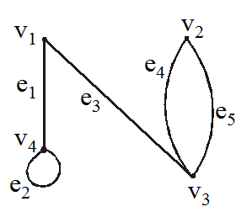
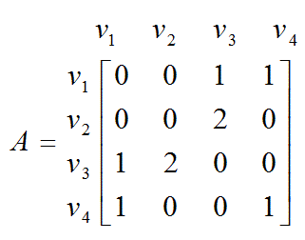
EXAMPLE
A graph with it’s adjacency matrix is shown.
Clearly graph has four vertices. It means that the corresponding square matrix will be order 4 x 4.

Slide 33
EXERCISE
Find a graph that have the following adjacency matrix.
Solution
Its order is 3 x 3, it means its corresponding graph has three vertices.
Let the three vertices of the graph be named v₁, v₂ and v₃

Slide 34
DIRECTED GRAPH
A directed graph or digraph, consists of two finite sets: a set V(G) of vertices and a set D(G) of directed edges,
where each edge is associated with an ordered pair of vertices called its end points.
If edge e is associated with the pair (v, w) of vertices, then e is said to be the directed edge from v to w and is represented by drawing an arrow from v to w.

Slide 35
EXAMPLE OF DIGRAPGH

Slide 36
ADJACENCY MATRIX OF A DIRECTED GRAPH
Let G be a graph with ordered vertices
v₁, v₂, …, v_{n}.
The adjacency matrix of G is the matrix A = [a_{ij}] over the set of non-negative integers such that
a_{ij} = the number of arrows from v_{i} to v_{j}
for all i, j = 1, 2, …, n.

Slide 37
EXAMPLE
A directed graph with its adjacency matrix is shown
Adjacency matrix

Slide 38
EXERCISE
Find directed graph that has the adjacency matrix
The order of matrix is 4 x 4, it means it has 4 vertices.

Slide 39
SOLUTION
The 4 × 4 adjacency matrix shows that the graph has 4 vertices say v₁, v₂, v₃ and v₄ labeled across the top and down the left side of the matrix.
A corresponding directed graph is
It means that a loop exists from v₁ and v₃ , two arrows go from v₁ to v₄ and two from v₃ and v₂ and one arrow go from v₁ to v_{3 ,} v₂ to v_{3 ,} v₃ to v_{4,} v₄ to v₂ and v_{3.}

Slide 40
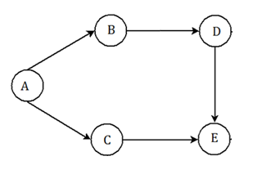
Graph Adjacency Matrix Representation
Draw adjacency matrix for given directed graph.
Solution:
The Given Graph
Graph G | A | B | C | D | E
A | 0 | 1 | 1 | 0 | 0
B | 0 | 0 | 0 | 1 | 0
C | 0 | 0 | 0 | 0 | 1
D | 0 | 0 | 0 | 0 | 1
E | 0 | 0 | 0 | 0 | 0
Graph G
The Solution

Slide 41
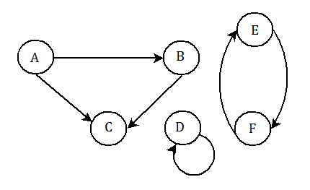
Graph Adjacency Matrix … Exercise
Draw adjacency matrix for given graph G:
Graph G

Slide 42
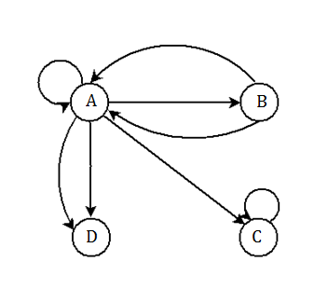
Graph Adjacency Matrix Representation
Draw the adjacency matrix of given graph G.
Solution
Pseudo Graph G
Graph G | A | B | C | D
A | 1 | 1 | 1 | 2
B | 2 | 0 | 0 | 0
C | 0 | 0 | 1 | 0
D | 0 | 0 | 0 | 0

Slide 43
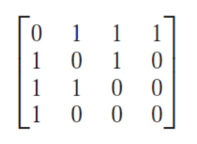
Graph Adjacency Matrix Representation …
Draw the graph with given adjacency matrix:

Slide 44
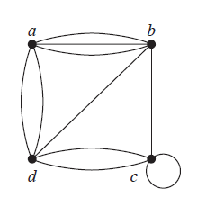
Graph Adjacency Matrix Representation …
Draw the adjacency matrix for the given graph.

Slide 45
INCIDENCE MATRIX OF A SIMPLE GRAPH
Let G be a graph with vertices v₁, v₂, …, v_{n} and edges e₁, e₂, …, e_{n}.
The incidence matrix of G is the matrix M = [m_{ij}] of size n × m defined by:

Slide 46
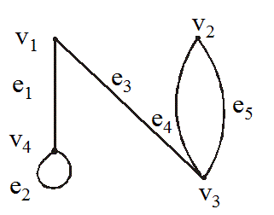
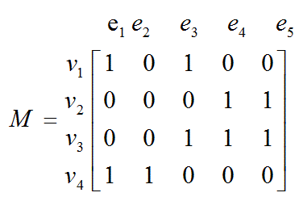
EXERCISE
A graph with its incidence matrix is shown.

Slide 47
REMARK
In the incidence matrix:
Parallel edges are represented by columns with identical entries (in this matrix e₄ & e₅ are parallel edges).
Loops are represented using a column with exactly one entry equal to 1, corresponding to the vertex that is incident with this loop and other zeros (here e₂ is only a loop).

Slide 48
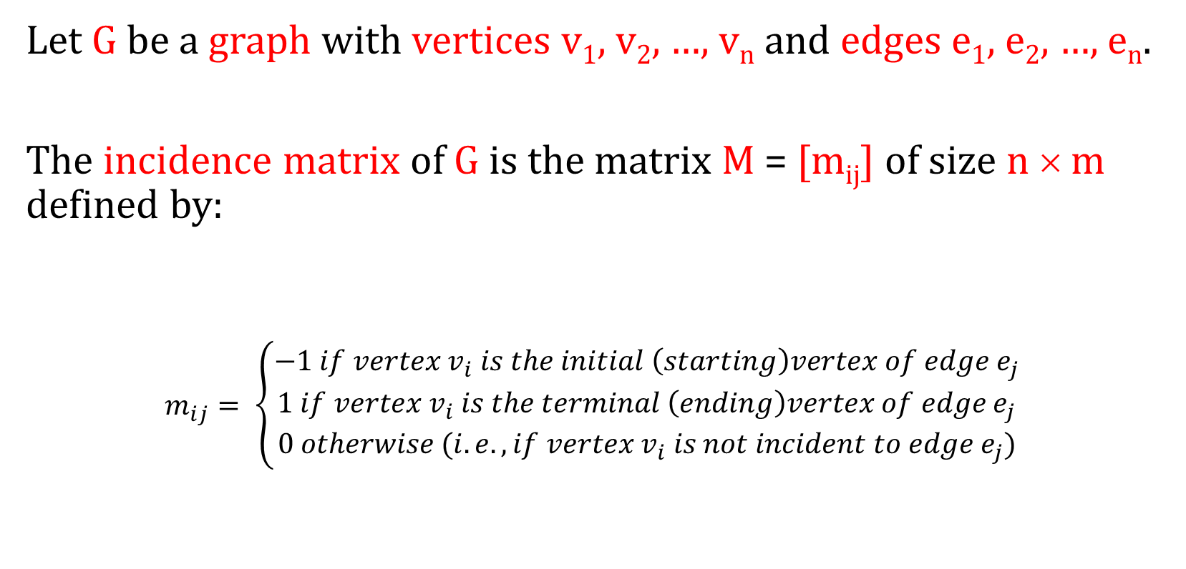
INCIDENCE MATRIX OF A DIRECTED GRAPH
Let G be a graph with vertices v₁, v₂, …, v_{n} and edges e₁, e₂, …, e_{n}.
The incidence matrix of G is the matrix M = [m_{ij}] of size n × m defined by:
$$m_{ij}= \left\{\begin{aligned}−1 if vertex v_{i} is the initial \left(starting\right)vertex of edge e_{j} \\ 1 if vertex v_{i} is the terminal \left(ending\right)vertex of edge e_{j} \\ 0 otherwise (i.e. , if vertex v_{i} is not incident to edge e_{j})\end{aligned}\right.$$

Slide 49
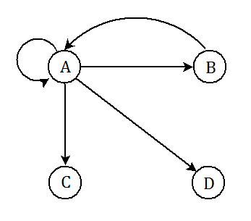
In Degree, Out Degree
In Degree:
Number of edges pointing into a vertex is called its in degree. In Degree of vertex A is 2
Out Degree:
Number of edges going out of a vertex is called its out degree.
Out Degree of vertex A is 4

Slide 50
In Degree, Out Degree
In Degree:
Number of edges pointing into a vertex is called its in degree In Degree of vertex A is 2
Out Degree:
Number of edges going out of a vertex is called its out degree
Out Degree of vertex A is 4
Note: Sum of degrees for all nodes of a graph is always even

Slide 51
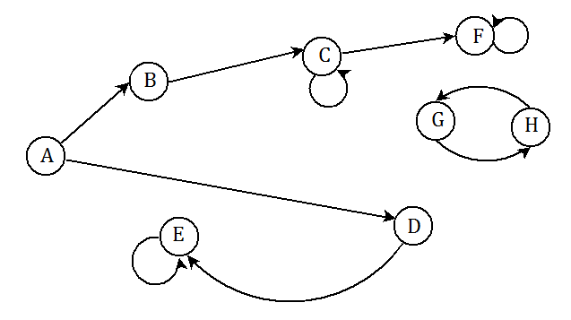
Degree, In Degree, Out Degree … Example
Calculate:
Degree of K
In degree of all vertices of K
Out degree of all vertices of K
Degree of sub-graph involving vertices G&H Only
Graph K

Slide 52
Degree, In Degree, Out Degree … Example
If each vertex of an undirected graph has degree k then the graph is called a regular graph of degree k.
How many edges are there in a directed graph of degree 6?
How many edges are there in a undirected graph of degree 10?
How many edges are there in a undirected graph of degree N?

Slide 53

Summary
The topics we covered:
Graphs
Terminologies
Types of Graphs
Matrix Representation of Graphs
Directed Graph

